Slide 1
Reimagining Influence Detection in Social Networks via Graph Neural Networks
Group: 08
Harshavardana Reddy Kolan Shikha Kumari

Slide 2
Contents:
Introduction
Problem Statement
Next Steps Integrated
Dataset
Data Collection
Data Cleaning & Preprocessing
Models
Classical Models (XGBoost)
Graph Neural Networks (GNN) Pipeline
Graph Structure
Node Types: For Stack Overflow - Users, Questions, Answers; AskReddit – Posts, Comments
Edge Types: For Stack Overflow - Asks, Answers, Has, Accepted Answer; AskReddit - Asks, Answers, Has
Heterogeneous GNN (HetGNN)
GraphSAGE Pipeline
Model Architecture Explanation
Model Training & Metrics
Training Setup: Stratified Mini-Batching
Metrics: Accuracy, Precision, Recall, F1-score, AUC
Conclusion & Future Work
Summary of Findings
Recommended Improvements

Slide 3
Introduction
Problem Statement:
Identifying influential users across social networks (Stack Overflow), Identifying active users acoss social network (Ask Reddit) for validation.
Objective:
Reward influential users to enhance participation, engagement, and content quality.
Recommend top users to those seeking expertise in related domains.

Slide 4
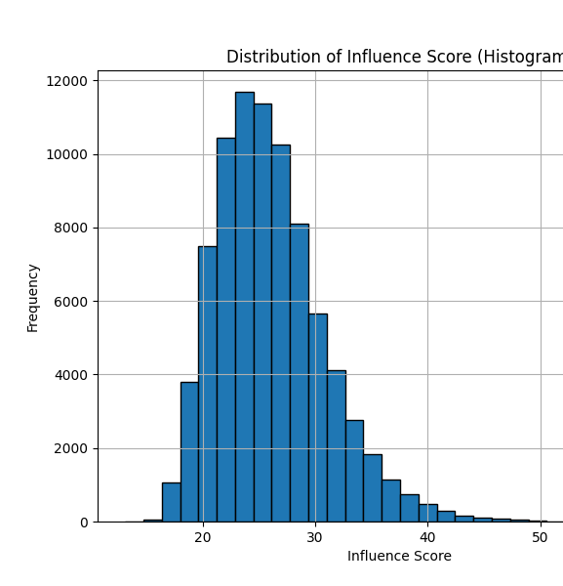
Dataset Overview – Stack Overflow
What is the dataset?
Stack Overflow interactions (Users, Questions, Answers)
AskReddit (Posts, Comments)
How did we extract it?
Collected using API – Stack Overflow
Downloaded from Kaggle - AskReddit
How did we transformed in the tabular form for classical models?
Formula to define influence:
influence_score=reputation+3*gold_badge_count+2*silver_badge_count+bronze_badge_count
The threshold for defining influential users is the users falling in the top 10% of influence_score.
Aggregated questions and answers by User ID to summarize user activity (total questions, average scores, accepted answers).
Merged the datasets(Users, Questions, Answers) to create a single, comprehensive dataset for classical models.

Slide 5
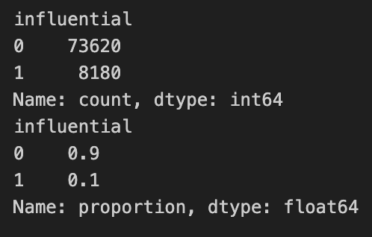
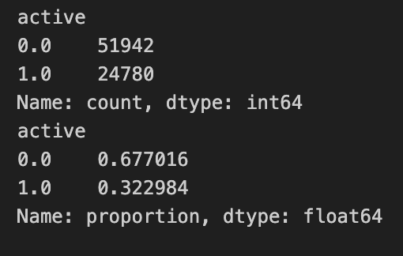
Dataset Overview – AskReddit
What is the dataset?
AskReddit (Posts, Comments)
How did we extract it?
Downloaded from Kaggle – A month of AskReddit
How did we transformed in the tabular form for classical models?
Formula to define influence:
Activity score= num_posts+num_comments
The threshold for defining influential users is the users falling in the top 10% of activity_score.
Aggregated questions and answers by User ID to summarize user activity (avg_post_score, total_comments, avg_comment_score).
Merged the datasets(posts and comments) to create a single, comprehensive dataset for classical models.

Slide 6
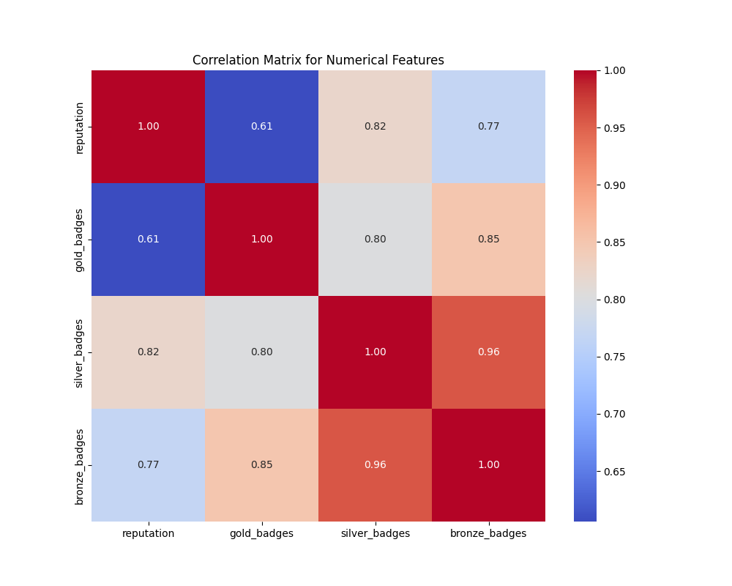
Preprocessing:
For Stackoverflow
Removed reputation and badge variables because:
High correlation between features
Used for defining target variable
For Ask Reddit:
Removed unwanted columns such as timestamp, title and url of the post.

Slide 7
Models Used:
Classical Models:
XGBoost for tabular learning.
Graph Neural Networks (GNN):
Used GarphSAGE: Heterogeneous Graph Representation for node classification.

Slide 8
Classical Model: XGBoost
Applied on structured tabular data
Features for Stack Overflow:
total_questions, avg_question_score, avg_answer_score, accepted_answers
Features for AskReddit:
avg_post_score, total_comments,avg_comment_score
Limitation:
Ignores relationships between users and content (questions and answers)

Slide 9
Why GNNs?
GNNs are essential for this problem because Stack Overflow interactions are inherently a networked structure.
Graphs Model Real-World Interactions:
Unlike tabular models, GNNs understand relational data.
This allows us to predict user influence based on their position in the network.
Message Passing & Information Propagation:
GNNs aggregate information from connected nodes.
Classical models fail to model this interaction effect.
Heterogeneous GNNs Adapt to Different Node Types:
Users, Questions, and Answers have different roles.
GNNs learn embeddings specific to each type of node (e.g., an expert vs. a beginner has different engagement patterns).

Slide 10
GNN Structure
Node Type (StackOverflow)
user, question, answer
Edge Type (StackOverflow)
user → asks → question
user → answers → answer
question → has → answer
question → accepted_answer → answer
Reverse edges
Self-loops added
Node Type (AskReddit)
author, post, comment
Edge Type (AskReddit)
author→ wrote_post→ post
author → wrote_comment → comment
post → has→ comment
Reverse edges
Self-loopsadded

Slide 11
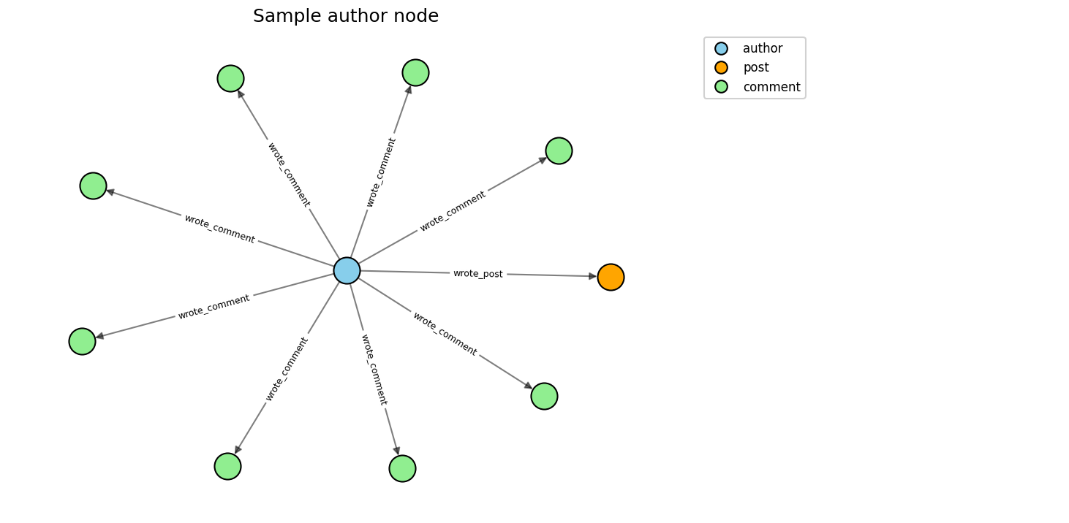
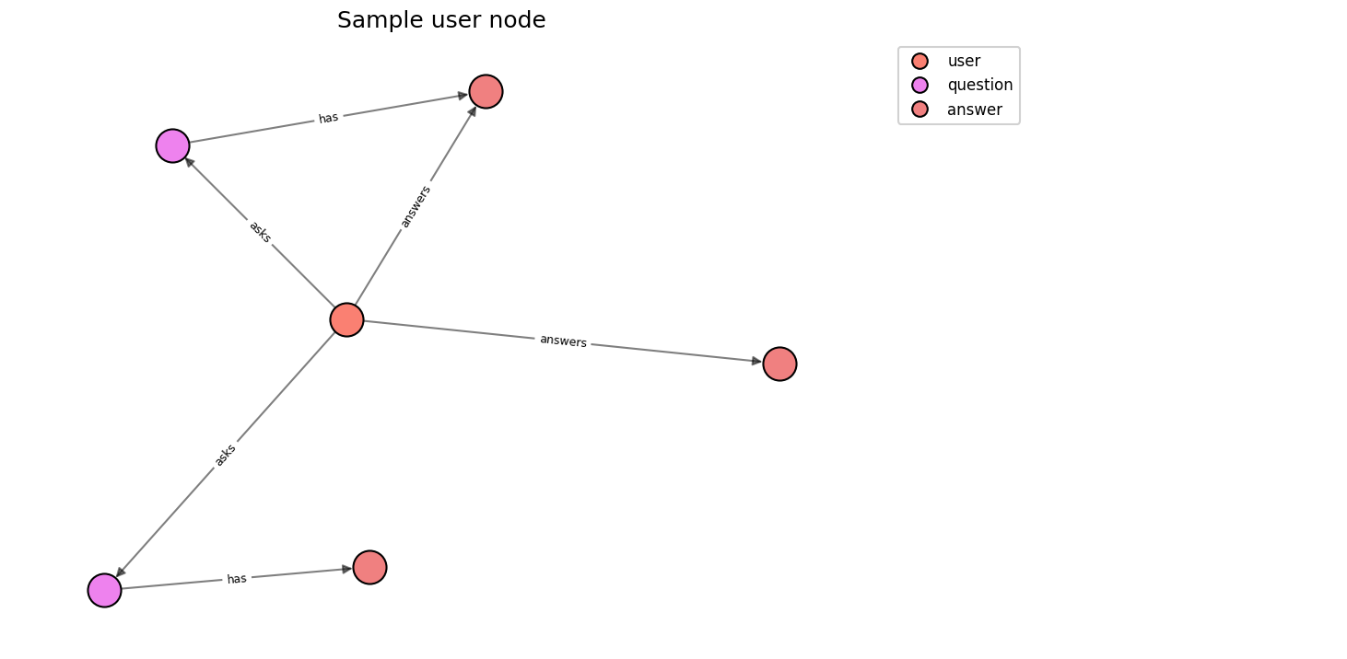
Visualization of Node and it's Neighbors

Slide 12
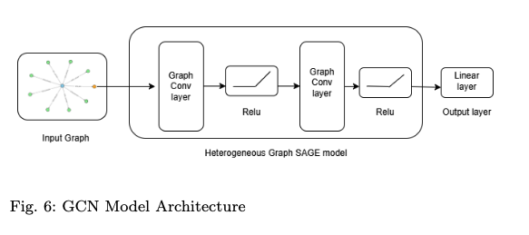
Training Pipeline
Takes an input graph with node features.
Uses a Heterogeneous GraphSAGE model for message passing.
Architecture consists of:
Graph Convolution Layer → aggregates neighbor information.
ReLU Activation → adds non-linearity.
Second Graph Convolution Layer → further refines node embeddings.
ReLU Activation → applied again for deeper representations.
Linear Layer (Output Layer) → maps final embeddings to prediction scores.
Suitable for tasks like node classification or link prediction in heterogeneous graphs.

Slide 13
Training Setup
🛠 Training Setup for Heterogeneous GNN
Graph Neural Network (GNN) Model:
Implemented using PyTorch Geometric
Uses Heterogeneous Graph Convolutions for multiple node and edge types: GraphSAGE
Hyperparameters:
Hidden Layers: 2-layer SAGEConv with 64 hidden units
Output channels: 2
Aggregation: Mean pooling to aggregate neighbor information
Learning Rate: 0.01
Num_epochs: 50
Batch Size: 64
Number of neighbours: [10,10]
Split: 'train_rest'
Optimizer: Adam(Weight Decay: 1e-4 for regularization)
Loss Function: Cross Entropy
Data Handling & Training:
Self-loops: Helps model user self-engagement patterns
Node Splitting: RandomNodeSplit (80% train, 10% validation, 10% test)
Stratified Mini-Batching for balanced sampling (necessary due to class imbalance) - New Addition
Mini-Batch Training: NeighborLoader for efficiency

Slide 14
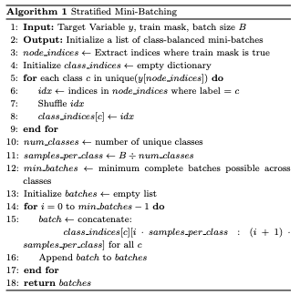
Stratified Sampling
Extract training indices:
Group indices by class:
Shuffle each class's indices:
Compute batching parameters:
samples_per_class: How many samples of each class should go into one batch.
min_batches: The number of complete batches we can form, based on the smallest class size.
Form batches:
Take the right slice of samples from each class's shuffled list.
Concatenate them to form one batch.
Return all batches.

Slide 15
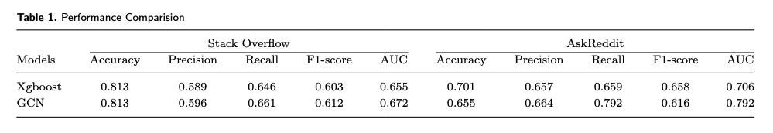
Evaluation Metrics
Both models perform well across datasets, with GCN showing slightly better overall metrics.
Despite a good AUC score for AskReddit, the ROC curve suggests underfitting, likely due to the model being too simple to capture complex patterns.

Slide 16
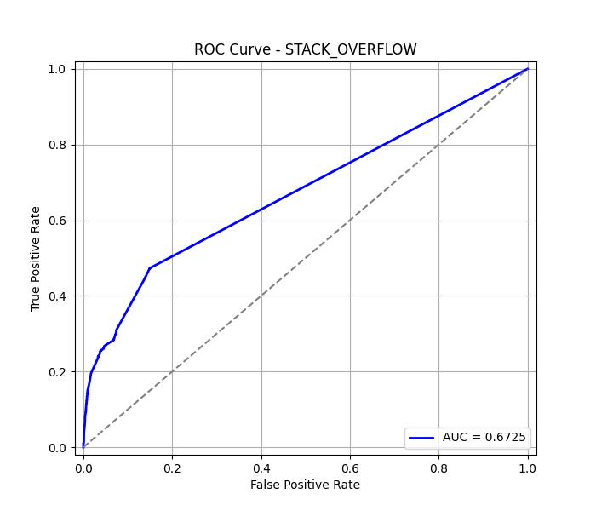
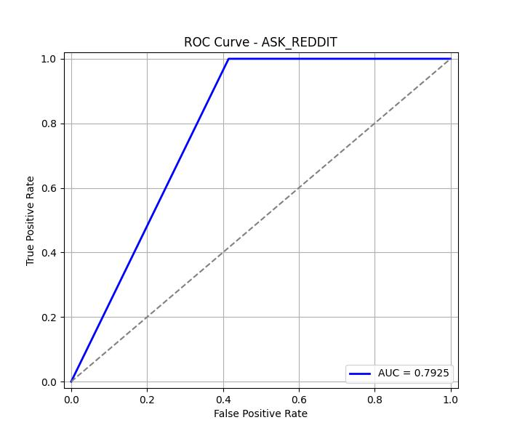
ROC Curve for GNN (Stack Overflow | AskReddit)

Slide 17
Future Work:
Increasing complexity of the models by number of layers, changing configurations.
Trying different models – like GAT
Extending to other platforms in Social Networks.

